Slide 1
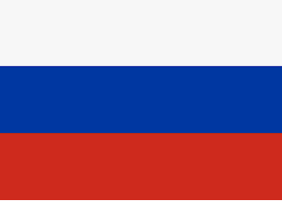
Resources for
Studying Russia & Central Asia
Peter Wood & Lionel Beehner
TRADOC G-2 – Foreign Military Studies Office
29 April 2024
This briefing is UNCLASSIFIED
Approved for public release. Distribution is unlimited
*Note that this is a study tool. Inclusion of a source does not imply USG or DOD endorsement of an entity’s views
Notes:
PLA Logo via Wikimedia Commons https://commons.wikimedia.org/wiki/File:China_Emblem_PLA.svg

Slide 2
Central repository of TRADOC G-2 and Army resources on Russia
https://oe.tradoc.army.mil/how-russia-fights/

Slide 3
Foreign Military Studies Office
FMSO is all about original-language sources and primary documents - FMSO's Operational Environment Watch journal provides translated selections and analysis from a diverse range of foreign articles and other media that our analysts believe will give military and security experts an added dimension to their critical thinking about the Operational Environment
Find analysis of Russian national strategy, technology and tactics
https://fmso.tradoc.army.mil/
This briefing is UNCLASSIFIED
3

Slide 4
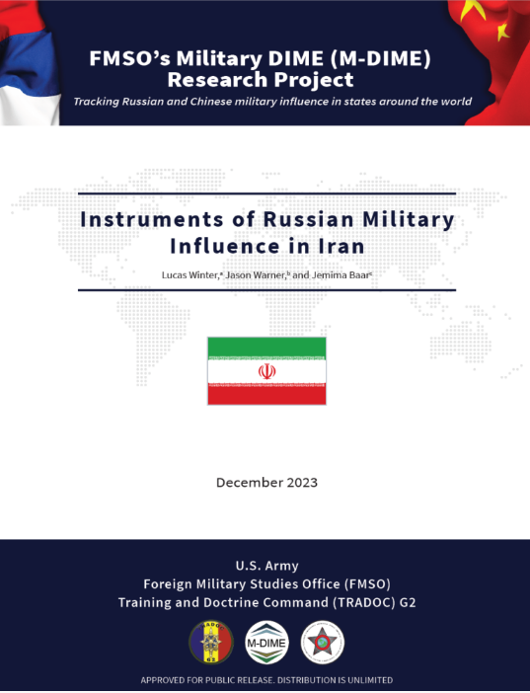
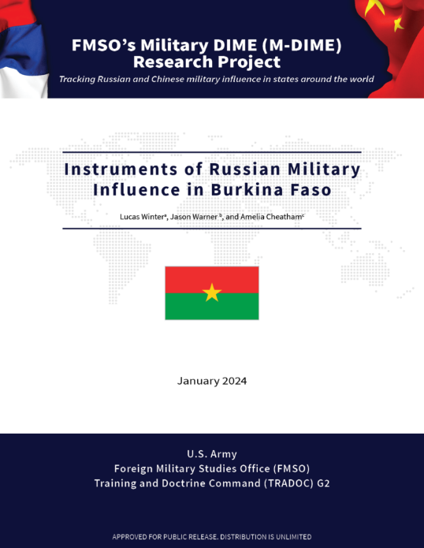
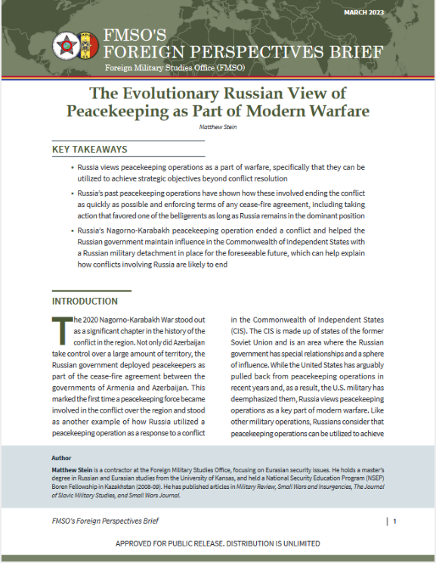
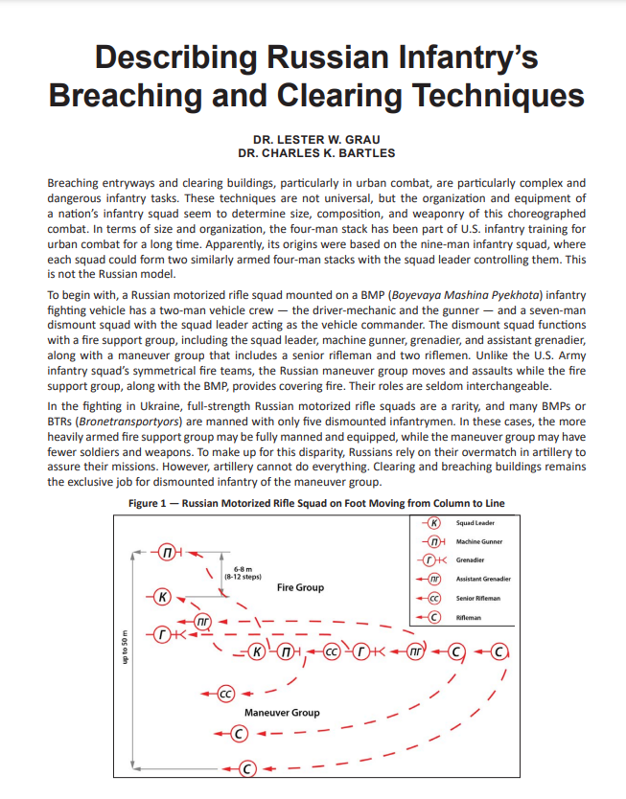
Russian Influence
Military DIME (M-DIME) Research Project – assessments of Russian influence in countries of interest - https://fmso.tradoc.army.mil/military-dime-research-project/
Foreign Perspective Briefs – Research grounded on authoritative foreign language materials
Latest – Evolution in Russian Peacekeeping https://fmso.tradoc.army.mil/2023/2023-03-24-the-evolutionary-russian-view-of-peacekeeping-as-part-of-modern-warfare-matthew-stein-update/
Articles in Professional Journals
Russian Infantry’s
Breaching and Clearing Techniques https://www.moore.army.mil/infantry/magazine/issues/2023/Winter/pdf/8_Grau-BartlesBreach_txt.pdf

Slide 5
Primary Sources
Exercise caution when accessing foreign websites. When possible, use cached versions etc and/or a VPN or other attribution management tools
Key Documents – Don’t just let people tell you about how Russian leaders think – see what they prioritize in some of the most important documents published by Putin’s regime:
Military Doctrine of the Russian Federation (2014) - English version here - might need to use cached version https://thailand.mid.ru/en/military-doctrine-of-the-russian-federation
National Security Strategy of the Russian Federation (2021) https://rusmilsec.files.wordpress.com/2021/08/nss_rf_2021_eng_.pdf
Vladimir Putin "On the Historical Unity of Russians and Ukrainians", Kremlin Website, 12 July 2021, https://webcache.googleusercontent.com/search?q=cache:AfyH_6UoeU4J:www.en.kremlin.ru/events/president/news/66181&hl=en&gl=us&strip=1&vwsrc=0
Why read? This article directly foreshadowed Putin’s decision to go to war.
"Address to the Federal Assembly," Kremlin Archive, 25 April 2005, https://web.archive.org/web/20100820034601/http://archive.kremlin.ru/appears/2005/04/25/1223_type63372type63374type82634_87049.shtml
Why read?: This is the speech where Putin said that the collapse of the Soviet Union as “the greatest geopolitical catastrophe of the 20th Century”

Slide 6
Podcasts
In Moscow’s Shadows – by Russia scholar Mark Galleotti https://podcasts.apple.com/us/podcast/in-moscows-shadows/id1510124746
I appreciate the breadth of elite politics to nitty gritty Spetznaz stuff and the dose of humor. Its also a little less ‘ideological’ (if that is the right word) than Brian Whitmore’s energetic but sometimes exhausting style in The Power Vertical blog/podcast
Next Year in Moscow from The Economist https://www.economist.com/moscowpod
This 8-part series is focused on interviews with the people inside Russia who protested and those who have left--the new Russian diaspora. I thought it was interesting that a lot of these people were not your typical human rights campaigners but also people who had received the approval of the state (actress Chulpan Khamatova who interacted with Putin on multiple occasions) or worked for the propaganda apparatus itself (Dmitry Likin--the guy behind Channel 1 TV). Easy way to get a lot of helpful context about how Russian people actually feel about the war.
Click Here – from Recorded Future - https://podcasts.apple.com/us/podcast/click-here/id1225077306
Covers the gamut of news on information and cyber operations but with detailed coverage of Russian criminal and state actors and Ukraine’s response

Slide 7
Studies & Books
Royal United Services Institute (RUSI) – The eminent British think tank has had excellent coverage of the war in Ukraine
Cranny-Evans, S., & Withington, T. (2022, March 9). Russian Comms in Ukraine: A World of Hertz. Retrieved from RUSI: https://rusi.org/explore-our-research/publications/commentary/russian-comms-ukraine-world-hertz
Jack Watling and Nick Reynolds, Ukraine at War: Paving the Road from Survival to Victory, Royal United Services Institute (RUSI), 4 July 2022. https://ik.imagekit.io/po8th4g4eqj/prod/special-report-202207-ukraine-final-web.pdf
Justin Bronk with Nick Reynolds and Jack Watling, “The Russian Air War and Ukrainian Requirements for Air Defence,” Royal United Services Institute, 7 November 2022. https://static.rusi.org/SR-Russian-Air-War-Ukraine-web-final.pdf
Center for Naval Analysis (USG-funded research Institute) has a number of dominant Russia scholars
Michael Kofman, Anya Fink, Dmitry Gorenburg, Mary Chesnut, Jeffrey Edmonds, and Julian Waller, "Russian Military Strategy: Core Tenets and Operational Concepts," Center for Naval Analyses, 6 August 2021. https://www.cna.org/archive/CNA_Files/pdf/russian-military-strategy-core-tenets-and-operational-concepts.pdf
Swedish Intelligence Service’s (FOI) series of reports:
“Russian Military Capability in a Ten-year perspective—2019” FOI - https://foi.se/rest-api/report/FOI-R--4758--SE
Their latest paper departs from the “10-year” perspective to focus on the Ukraine war but it is exhaustive in its detail in the best possible way. Russia᾽s War Against Ukraine and the West: The First Year, FOI, 20 June 2023. https://www.foi.se/en/foi/reports/report-summary.html?reportNo=FOI-R--5479--SE
Congressional Research Service – produces excellent products that are hard to beat in terms of conciseness for getting up to speed on a topic
Andrew S. Bowen, Russian Armed Forces: Capabilities, 30 June 2020. https://crsreports.congress.gov/product/pdf/IF/IF11589
*Highly Recommend* Andrew S. Bowen, Russian Arms Sales and Defense Industry, Congressional Research Service, 14 October 2021. https://crsreports.congress.gov/product/pdf/R/R46937
Cory Welt, Rebecca M. Nelson, Russia: Domestic Politics and Economy, Congressional Research Service, 9 September 2020. https://crsreports.congress.gov/product/pdf/R/R46518
Books:
Galleotti - Putin’s Wars: From Chechnya to Ukraine (2022) – Provides digestible overview of the arc of events from the 1990s coup attempts, Caucasus conflicts and Syria, along with descriptions of each of the modernization ‘eras’ from Makarov to Shoigu is really helpful as I read PRC publications on the same stuff.

Slide 8
Russian influence & cyber operations
Books:
Greenberg, Andy. Sandworm: A New Era of Cyberwar and the Hunt for the Kremlin’s Most Dangerous Hackers, Knopf Doubleday Publishing Group, 2019.
McCauley, Kevin Russian Influence Campaigns against the West: From the Cold War to Putin, October 2016.
McGlynn, Jade, Memory Makers: The Politics of the Past in Putin’s Russia, Bloomsbury Press, 2023.
Pomerantsev, Peter. This Is Not Propaganda: Adventures in the War Against Reality. PublicAffairs, 2019.
Rid, Thomas. Active Measures: The Secret History of Disinformation and Political Warfare. Farrar, Straus and Giroux, 2020.

Slide 9
Reliable Sources of Analysis
Politics & Foreign Policy
Economics & Development
OE
Watch
Military
These are in my opinion the best sources of analysis on these topics. Many RFIs can be answered, or at least refined, by first checking existing literature from these sources – links by clicking icons
This briefing is UNCLASSIFIED
Technology & Innovation
Notes:
Does not include blogs, newsletters, or think that largely focus on U.S. policy (CNAS), or those that only sporadically have China content, or do not have a direct regional focus as Johns Hopkins APL (https://www.jhuapl.edu/NewsPublications/Publications ) which has had excellent, but periodic or project focused coverage

Slide 10
Media Sources
Podcasts
RFE/RL’s “Majlis”
Mark Galeotti “In Moscow’s Shadows”
The Caucasus Digest - OC Media
The Armenian Harvest
Independent local media
Kloop (Kyrgyzstan)
Vlast (Kazakhstan)
Fergana News (Uzbekistan)
OC-Media (Southern Caucasus)
I-Stories Media (Russia/CA)
Barents Observer (Baltics)
CABAR (Central Asia)
Kyiv Independent (Ukraine)
Re-Russia.net (Russia)
Other News/NGOs
Meduza
EurasiaNet
Crossroads Central Asia
Jamestown Eurasia Daily Monitor
IWPR
Detector Media
Media Zona (anti-war blog)
The Times of Central Asia (business)
On Russian Disinformation
DFRLab
EU DisinfoLab
Qurium Media Foundation
Institute for Strategic Dialogue
StopFake.org
This briefing is UNCLASSIFIED
Notes:
Collected by Peter Wood. Most sources report on multiple topics--categories are not absolute. The following is intended purely as a resource to assist with research on China and inclusion does not imply endorsement of any position taken by the included institution and publications.

Slide 11
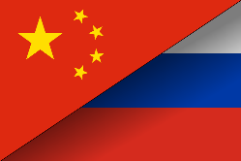
UNCLASSIFIED
China-Russia Relations
Highly recommend you read the full Joint Statement signed by Russia and China right before the war in Ukraine began
https://www.airuniversity.af.edu/Portals/10/CASI/documents/Translations/2022-02-04%20China%20Russia%20joint%20statement%20International%20Relations%20Entering%20a%20New%20Era.pdf
For a shorter overview of what it all means check this out
Peter Wood, "China-Russia Pledges of Deeper Cooperation Show Tangible Results," Operational Environment Watch, March 2022. https://community.apan.org/wg/tradoc-g2/fmso/m/oe-watch-articles-2-singular-format/408849
If you are looking to get up to speed on China-Russia, this article does a great job of providing an empirical grounding for understanding their cooperation through 2019
Korolev, A. How closely aligned are China and Russia? Measuring strategic cooperation in IR. Int Polit 57, 760–789 (2020). https://doi.org/10.1057/s41311-019-00178-8
A digestible but well-grounded history of Sino-Russian relations:
Lo, Bobo. A Wary Embrace: A Lowy Institute Paper: Penguin Special: What the China-Russia relationship means for the world. Penguin Books Ltd, 2017.

Slide 12
Recommended Books on Central Asia
Tom Bissell, Chasing the Sea: Lost Among the Ghosts of Empire in Central Asia, Knopf, 2004.
Alexander A. Cooley, John Heathershaw, Dictators Without Borders: Power and Money in Central Asia, Yale UP, 2019.
Erika Fatland, Sovietistan: Travels in Turkmenistan, Kazakhstan, Tajikistan, Kyrgyzstan, and Uzbekistan, Pegasus, 2020
Valery Hansen, The Silk Road: A New History, Oxford UP, 2012.
Jonathan E. Hillman, Emperor’s New Road – China and the Project of the Century, Yale UP, 2020.
Adeeb Khalid, Central Asia: A New History from the Imperial Conquests to the Present, Princeton UP, 2021.
This briefing is UNCLASSIFIED

Slide 13
Questions?
Feel free to reach out if you have additional questions:
Peter Wood
peter.a.wood9.civ@army.mil

