Slide 1
TRADOC OE OPFOR DIRECTORATE
SCENARIO DEVELOPMENT
A Structured Approach

Slide 2
Introduction
The Army's ability to train effectively for modern warfare relies on realistic and structured scenario development. There is a comprehensive framework for designing training exercises that replicate complex operational environments (OEs). This document outlines methodologies for developing scenarios for training and education that reflect real-world challenges.
Training in the Army is divided into three primary domains: operational, institutional, and self-development. Each domain plays a critical role in shaping soldiers' capabilities.
Operational training focuses on field-based exercises that prepare units for real-world missions.
Institutional training develops foundational knowledge through structured courses.
Self-development training encourages continuous learning to enhance professional competence.
Scenario-based training integrates these domains to create multi-dimensional operational environments where soldiers must apply skills in realistic conditions.

Slide 3
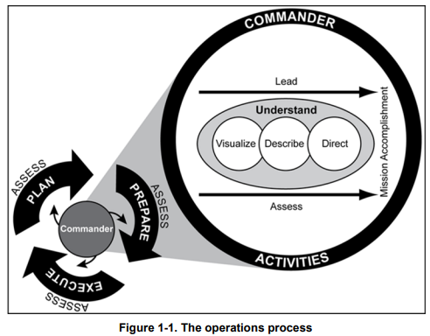
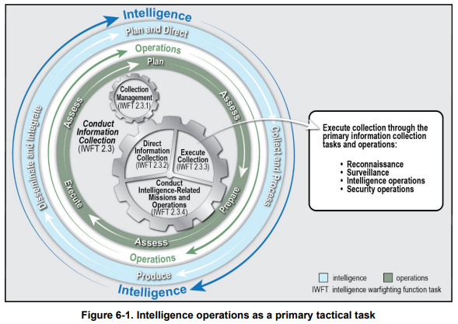
Principles of Design
Have a clear and transparent method – what is the goal?
Interact with all planning efforts
Understand the operations and intelligence processes
Understand the decision-making process
Understand how the training audience will interact with the OE

Slide 4
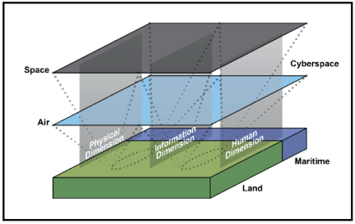
Step 1: Define the OE
Like the first step of the Intelligence Preparation of the Operational Environment, the first step in developing a scenario is to define the OE. The OE must provide sufficient in-depth information to allow the training audience to understand the threat, terrain, weather, and civil considerations involved and its effects on operations, facilitate evaluation of the threat, and determine threat courses of action (COAs).
The operational environment that is created should contest the unit’s objectives in all five domains (land, maritime, air, space, and cyberspace), three dimensions (physical, information, and human), and the electromagnetic spectrum.

Slide 5
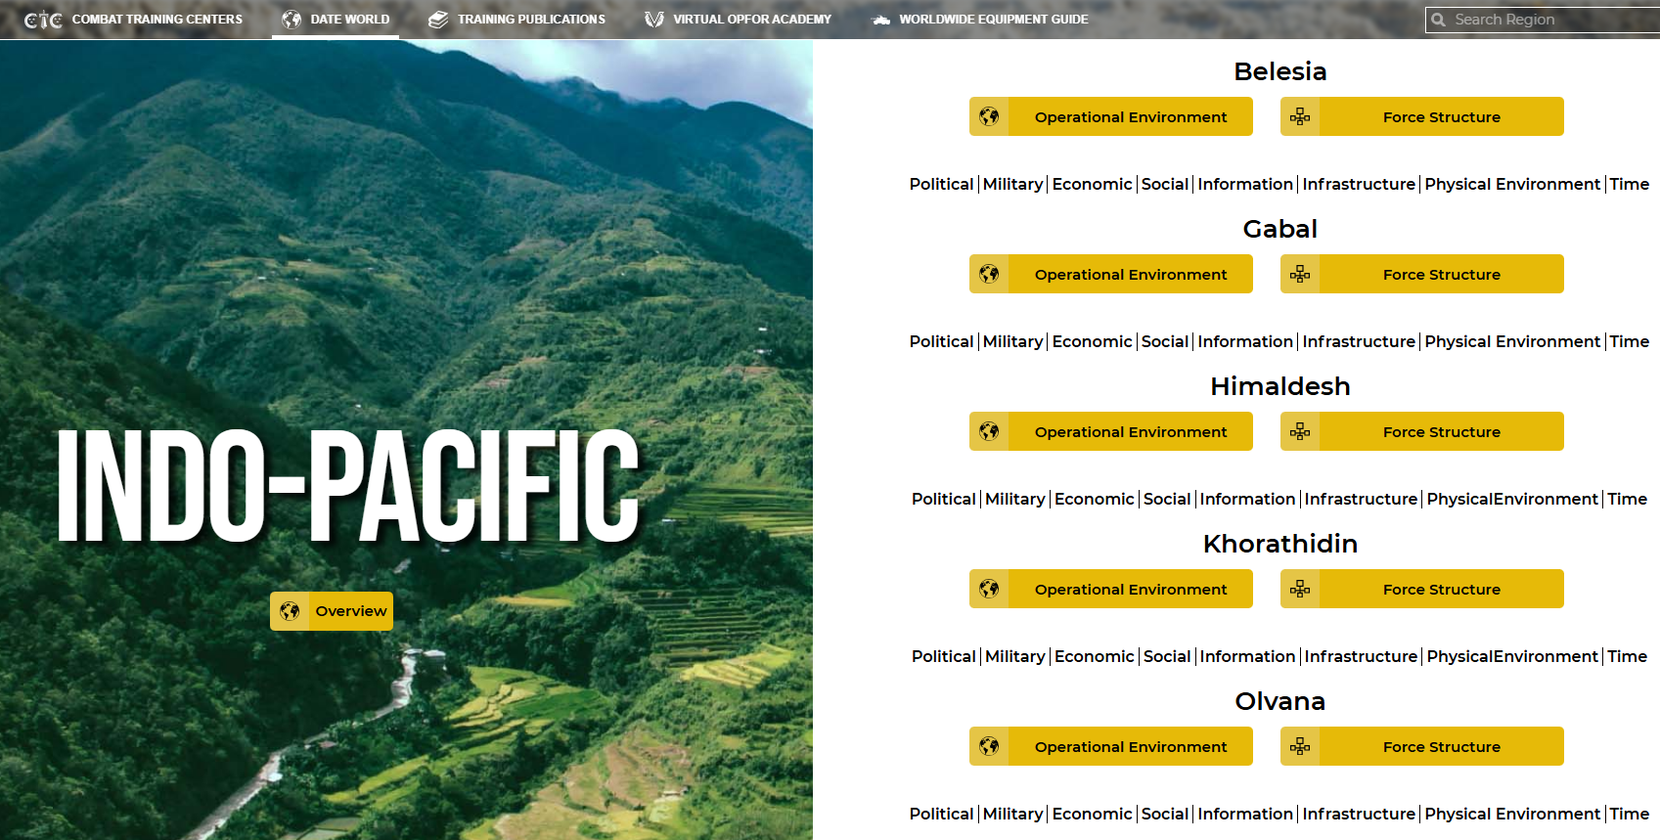
Step 2: Select OPFOR Structure
As with the OE, there are several options for selecting an opposing force (OPFOR) for the scenario. The OPFOR can be based on actual country or as a composite of an OPFOR structure from the DATE WORLD construct located at https://odin.tradoc.army.mil/DATEWORLD
The exercise design team will make the decision whether to train against an actual adversary or against a composite OPFOR.
Each DATE country has a unique Administrative Force Structure that is organized as an “in garrison” force and is not task organized to conduct operations. Force Structures can be used off the shelf; however, to optimize training objectives, it is recommended that scenario developers specifically task-organize the Order of Battle by considering all relevant factors.
https://oe.tradoc.army.mil/date-decisive-action-training-environment/

Slide 6
Step 3: Select OPFOR Countertasks
After a threat OB has been selected, task organized, and equipped the exercise planner and the training unit has identified its tasks, the scenario developer can select the OPFOR tactical tasks and missions.
The exercise planner/scenario developer should select OPFOR countertasks that –
oppose the training unit’s training objectives IAW approved OPFOR tactical tasks.
are reflected in the ATP 7-100 and TC 7-100 series of manuals.
are appropriate to the OE selected for the exercise.
Training Publications can be found at https://odin.tradoc.army.mil/TC
OPFOR Tactical Task List can be found in:
TC 7-101, Appendix B
TC 7-102, Appendix C

Slide 7
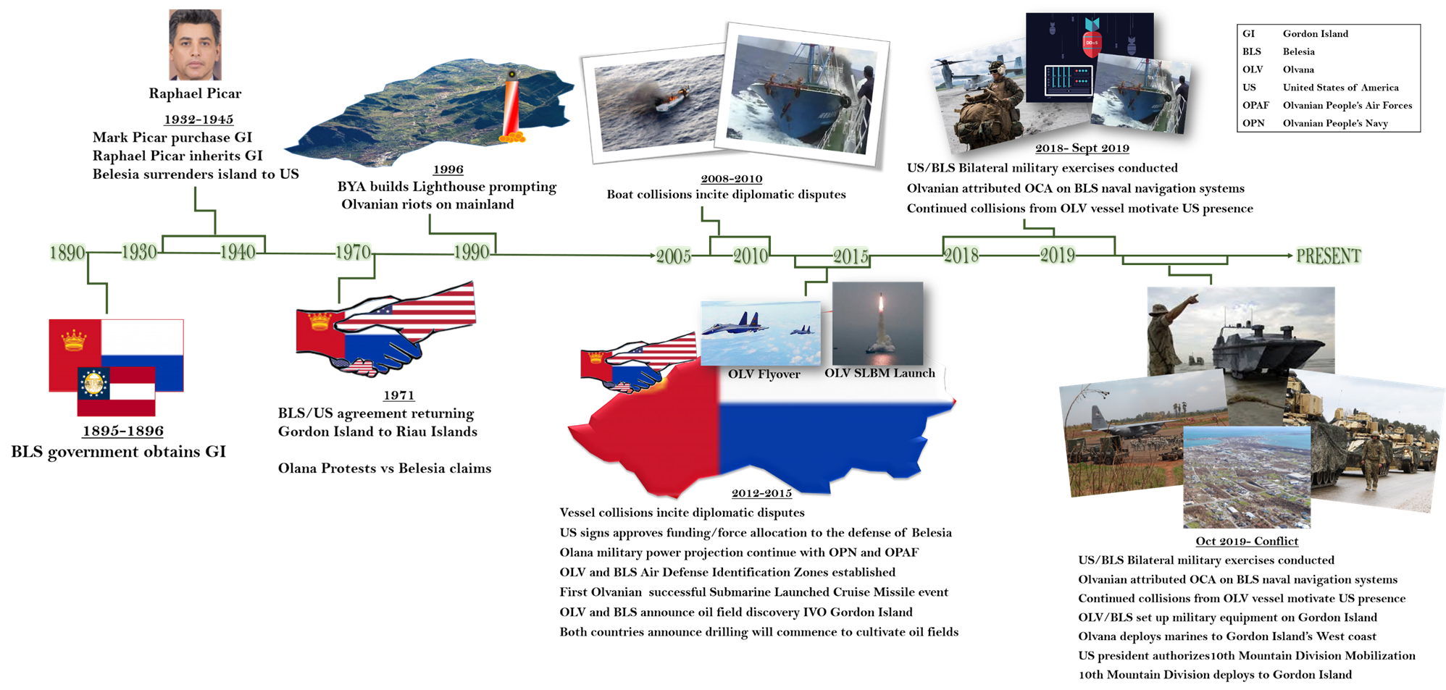
Step 4: Develop the Road to War
To develop effective training, the OE (that was developed in Step 1) is altered using an exercise road-to-war (RTW). The RTW is a sequence of events designed to describe the DIME-FIL strategic and/or PMESII-PT operational variables on the conflict continuum. It represents a comprehensive strategic and operational synthesis of terrain, threat, weather, civil considerations, and a timeline of events and actions leading to the start of an exercise (STARTEX). The RTW can and should incorporate real world events to add realism and blend the scenario into historic events. Of note, many combatant commands demand “ripping” the exercise scenario from the news.

Slide 8
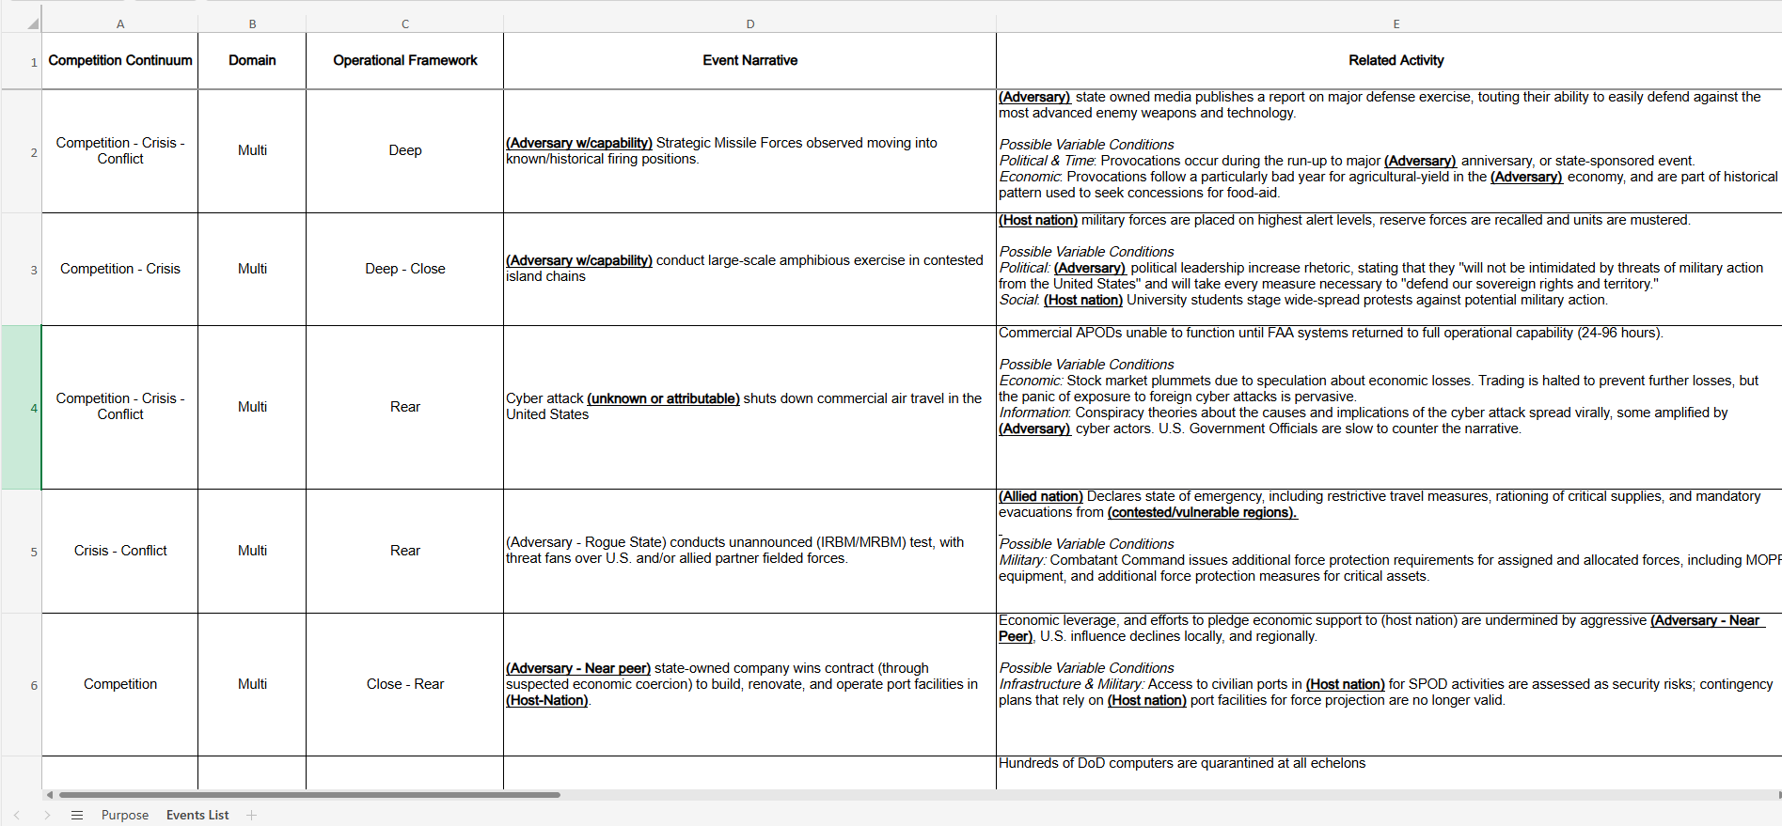
Step 5: Develop a MSEL
The Master Scenario Event List (MSEL) is the main tool produced by the exercise planners and scenario developers, maintained by the exercise control (EXCON) group, and structured on the main events that support the achievement of the exercise and training objectives. Each main event will have one or more incidents that are presented to audiences by means of injects. The MSEL is developed from the approved unit training objectives and focuses on developing themes appropriate to the exercise.
The MSEL should include actions or events in all five domains and three dimensions, the information environment, electromagnetic spectrum, and across the range of Army, Joint, Multinational Partner, and OPFOR operations. MSEL development may occur several times during exercise design and scenario development.
The U.S Army Training and Doctrine Command G-2 has developed the DATE Events List that provides a small sample of possible events that can be applied to any DATE-based scenario. These events characterize a broad range of threats and challenges in any operational environment. Instructional Designers and Scenario Developers can use this list as a starting point for Master Scenario Events List (MSEL) development and modify them to suit their individual scenario and training objectives.
https://oe.tradoc.army.mil/2025/02/11/tradoc-g2-develops-date-events-list/

Slide 9
Step 6: Develop IE Messaging
The information environment is the aggregate of social, cultural, linguistic, psychological, technical, and physical factors that affect how humans and automated systems derive meaning from, use, act upon, and are impacted information, including individuals, organizations, and systems that collect, process, disseminate, or use information (JP 3-04).
The information environment, for example, is used during an exercise to shape the OE by using friendly, neutral, and threat information warfare; controlling narratives, messages, and themes; and attacking telecommunications systems and infrastructure. (Refer to ADP 3-13 for a detailed discussion of information within an operational environment).
The development of the information considerations can be achieved using the Information Operations Network (ION) ION is intended to provide an immersive information environment which emulates social media and digital domains. ION content is housed on closed intranets and is unique to each exercise and accessed via the web to allow the training audience access to the social media environment specific to their scenario during the exercise.
https://oe.tradoc.army.mil/ion-information-operations-network/

Slide 10
Step 7: Develop Intelligence Reporting
Intelligence drives the conduct of operations and operations enable intelligence, making intelligence and operations inseparable. To ensure training events and exercises operate effectively and efficiently, intelligence products must be developed and delivered to the right person at the right time and place. Intelligence developed for training supports commanders and staffs and other decision makers and are used to execute collective training tasks.
The categories of intelligence products can and do overlap; each category can be used to stimulate the training event or exercise.
- Warning intelligence is intended to detect threat activity and forewarn of hostile actions or intentions against the training unit. Warning intelligence can describe the threat’s use of new capacity and capabilities, tactics, or course of action (COA).
- Current intelligence provides time-sensitive intelligence and information reporting on the area of operations (AO). The term current is relative to the exercise design and scenario development that is created for use during the training event or exercise.
- General intelligence is intelligence concerning the military capabilities of threat country or organizations, or topics affecting the training event or exercise (joint, interagency, intergovernmental, and multinational) operations.
- Target intelligence is intelligence that portrays and locates the target or target complex and indicates its importance.
- Counterintelligence is information gathered and activities that identify, deceive, exploit, disrupt, or protect against espionage, other intelligence activities, sabotage, or assassinations conducted for or on the behalf of the threat during the training event or exercise.
- Estimative intelligence is intelligence that identifies and describes threat capabilities and intentions and provides courses of action for future military operations.
- Identity intelligence is the intelligence resulting from processing identity attributes concerning individuals, groups, networks, or populations of interest.

Slide 11
Step 8: Layer Warfighting Function Actions
The purpose of the incorporating warfighting functions actions during training events or training exercises is to stimulate the training audience to respond to multiple dilemmas to achieve their training objectives and accomplish assigned missions.
Command and Control (C2). The C2 warfighting function is the related tasks and a system that enables commanders to synchronize and converge all elements of combat power (ADP 3-0). If communications between elements on the battlefield are not maintained it affects the integration of all the other elements of combat power (movement and maneuver, intelligence, fires, sustainment, protection, information, and leadership) to achieve objectives and accomplish missions. Consider the following when developing a scenario: During a training exercise, does the network passing and receiving information need to be compromised in order to have the training audience restore the situation or execute a PACE plan?
Movement and Maneuver. The movement and maneuver warfighting function is the related tasks and systems that move and employ forces to achieve a position of relative advantage over the enemy and other threats (ADP 3-0). The movement and maneuver warfighting function includes tasks associated with force projection. Consider the following when developing a scenario: Are threat actions or injects required to stimulate early warning and/or protection of TA forces during the exercise?
Intelligence. The intelligence warfighting function is the related tasks and systems that facilitate understanding the enemy, terrain, weather, and civil considerations, and other aspects of the operational environment. Consider the following when developing a scenario: Does the scenario require specific injects, actions, or reports that drive intelligence support to force generation, situational understanding, information collection, or targeting?
Fires. The fires warfighting function is the related tasks and systems that create and converge effects in all domains against the threat to enable actions across the range of military operations (ADP 3-0). Consider the following when developing a scenario: Does the threat have a relative advantage in terms of time and space and sanctuary? What kind of tactical challenges or problems sets can the threat generate across multiple domains and dimensions to affect employment of the U.S. forces?
Sustainment. The sustainment warfighting function is the related tasks and systems that provide support and services to ensure freedom of action, extended operational reach, and prolong endurance (ADP 3-0). Sustainment determines the depth and duration of Army operations (ADP 3-0). Even during training exercises, successful sustainment enables freedom of action by increasing the number of options available to the commander. Sustainment is essential for retaining and exploiting the initiative. Consider the following when developing a scenario: Do logistics, personnel services, and health service support links require specific enemy force actions or injects during the training exercises? How will it affect the employment of the training unit and its ability to accomplish training tasks and complete assigned missions?
Protection. The related tasks, systems, and methods that prevent or mitigate detection, threat effects, and hazards to preserve combat power and enable freedom of movement. Consider the following when developing a scenario: What actions can be written into the scenario that force commanders and staffs to account for threats from space, cyberspace, and outside their assigned area of operations (AO) as they develop protection measures?

Slide 12
Step 9: Layer Cyberspace and the EMS Actions
In decisive action scenarios, cyberspace and electromagnetic warfare (EW) are essential to gaining advantages needed to conduct successful operations. There may be a requirement to layer threat cyberspace operations and electromagnetic warfare actions in a scenario. The actions could include such simulations as communications jamming to provide realism that emphasizes the importance of primary, alternate, contingency, and emergency plans. Training units may need conditions that require a unit to conduct cyberspace operations (defensive or offensive) and electromagnetic warfare (attack, protection, support) to gain and maintain information advantage and support combined arms maneuver.
See FM 3-12 Cyberspace Operations and Electromagnetic Warfare for additional information on how to integrate Cyberspace and EW into training scenarios.

Slide 13
Step 10: Layer Joint and Coalition Partner Actions
If the exercise or event has Joint or Coalition (warfighting functions are slightly different if joint or coalition) partner enablers, there may be a need to layer their force structure and capabilities and describe their LVC actions in the Master Scenario Event List (MSEL) as part of the scenario development. For large-scale exercises, according to the Joint Event Training Handbook, injects may be needed from the following:
Component Response Cells (Army, Air Force, Navy, Marines, Special Joint Operations Task Force). These cells will role-play organizations/commanders and replicate joint actions in support of training objectives.
Coalition Partner Cells (Significant Multinational Partners (SMNP)). These cells will replicate SMNP actions in support of exercise and training objectives.
Information Operations. This cell replicates IO and Cyber activities above and below the TAs, as well as certain threat forces stimulus (live and scripted) to create the IO training environment.
Cyberspace Operations Exercise Response Cells. This cell will ensure that there is a synchronized and realistic exercise cyberspace environment and provide the requisite intelligence and information is support of Cyberspace Operations storylines.
Interagency Response Cell. This cell replicates the functions of all US government agencies (USG) as well as international and non-governmental organizations (IOs and NGOs) in concert with the exercise scenario to support exercise/training objectives.
Sustainment/Deployment/Logistics/Medical/Combat Service Support Response Cell. This cell will replicate or role-play sustainment, deployment/redeployment, medical, mortuary affairs, aerial evacuation, transportation, chaplain. This cell could prepare responses to TA requests for information (RFI) concerning such areas as logistics, port infrastructure information, port throughput data, strategic lift allocation, host-nation transportation, medical and engineering issues, and general host-nation support.

Slide 14
Step 11: Develop Orders, Plans, and Instructions
Orders, plans, and instructions development refers to all the materials and products issued by the exercise director and staff to the training unit. Normally this includes operation orders (OPORDs), operation plans (OPLANs), overlays, warning orders (WARNORDs), fragmentary orders (FRAGORDs), country studies, intelligence estimates, and adjacent unit orders—in short, all documents required for the training unit to exercise its staff and Soldiers during the exercise.
Scenario products that were created during development will be finalized by scenario developers and delivered to the exercise planner. The product list, not all-inclusive, could consist of the following:
Operational Environment Assessments
Roads-to-War
Master Scenario Event List
OPFOR Structure and Capabilities
OPFOR Campaign Plan
Role Player Cards, Instructions, and Scripts
IE Messaging using ION
Historical Information and Intelligence Reporting
Warfighting Function Layers
Cyberspace and EMS Layers
Joint and Coalition Partner Layers
Operation Orders and Associated Annexes
OPFOR Orders and Plans

Slide 15
TRAINING SUPPORT
https://oe.tradoc.army.mil/opfor-opposing-forces-program/training-support/

